Slide 1
IaRT – CHECKPOINT 1
Daniel Brandão – 201705812
Pedro Moás – 201705208
Gaspar Pinheiro - 201704700

Slide 2
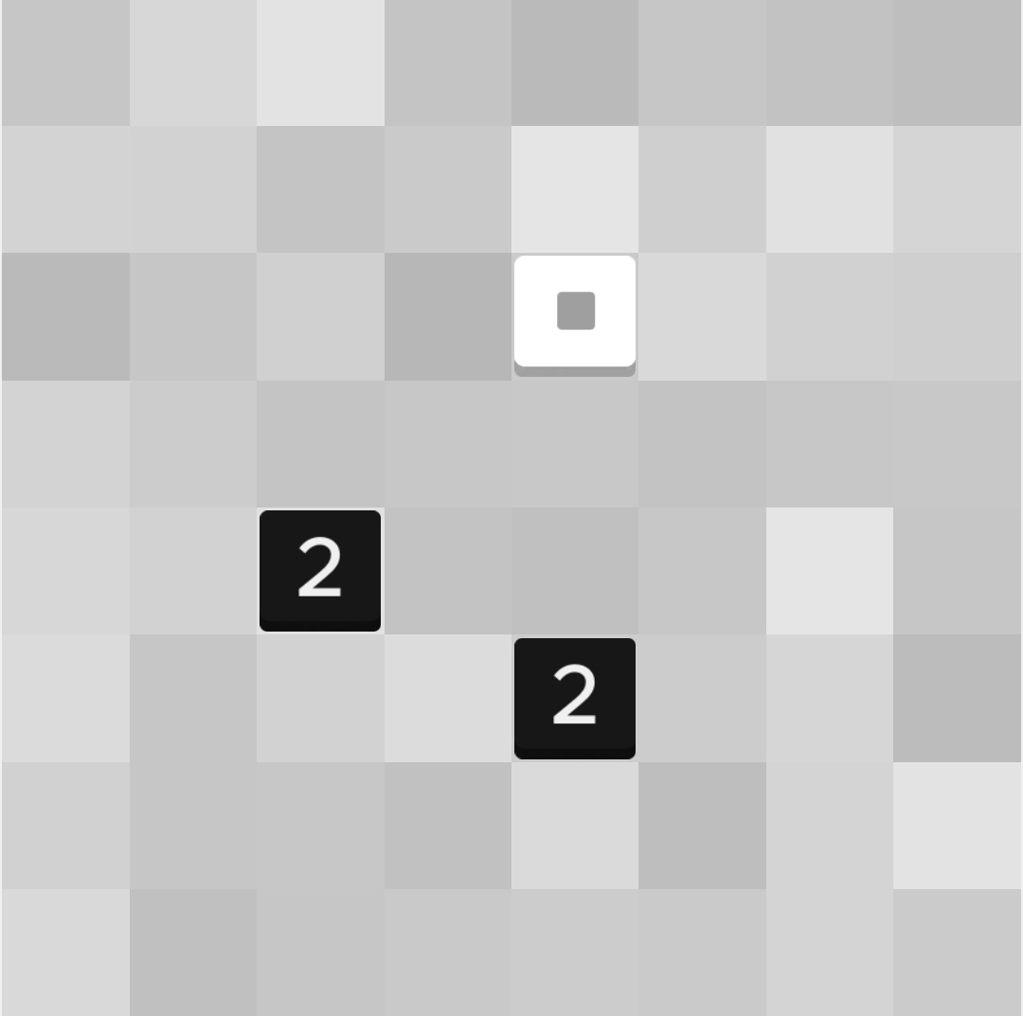
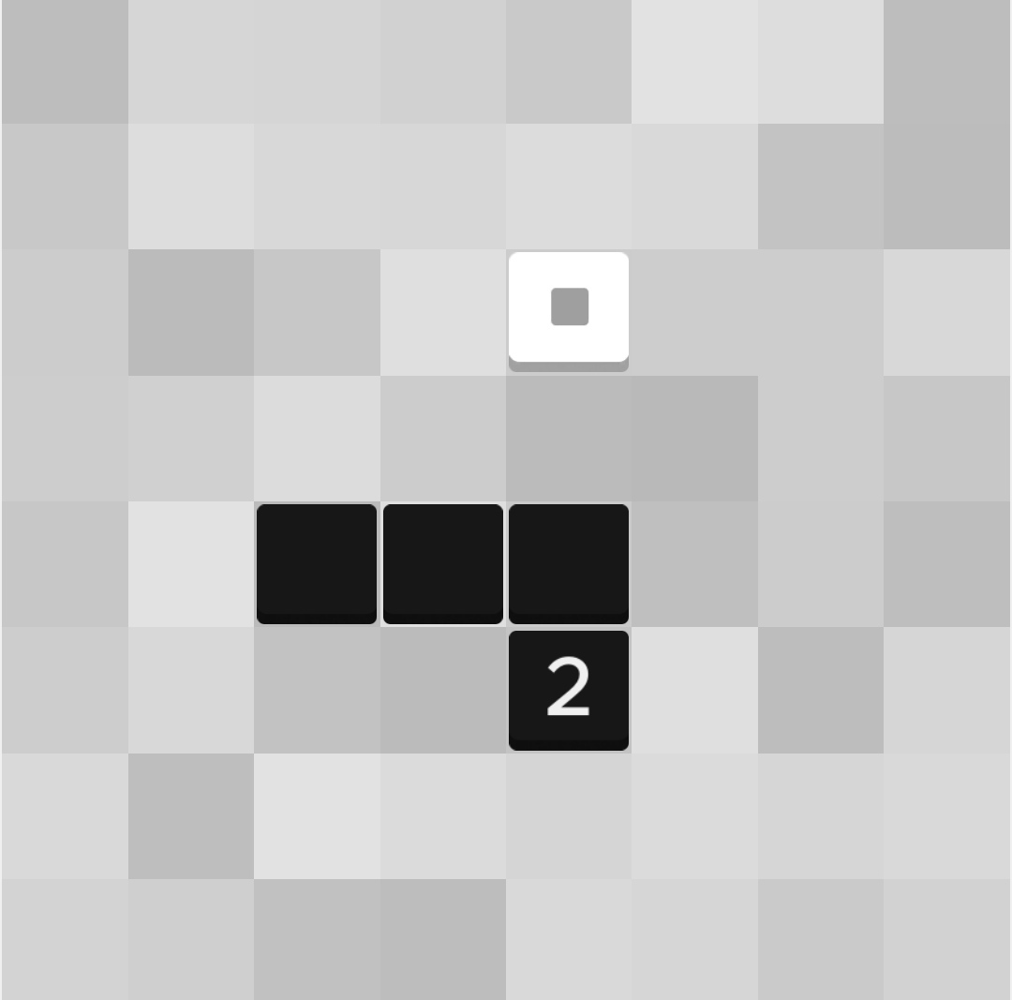
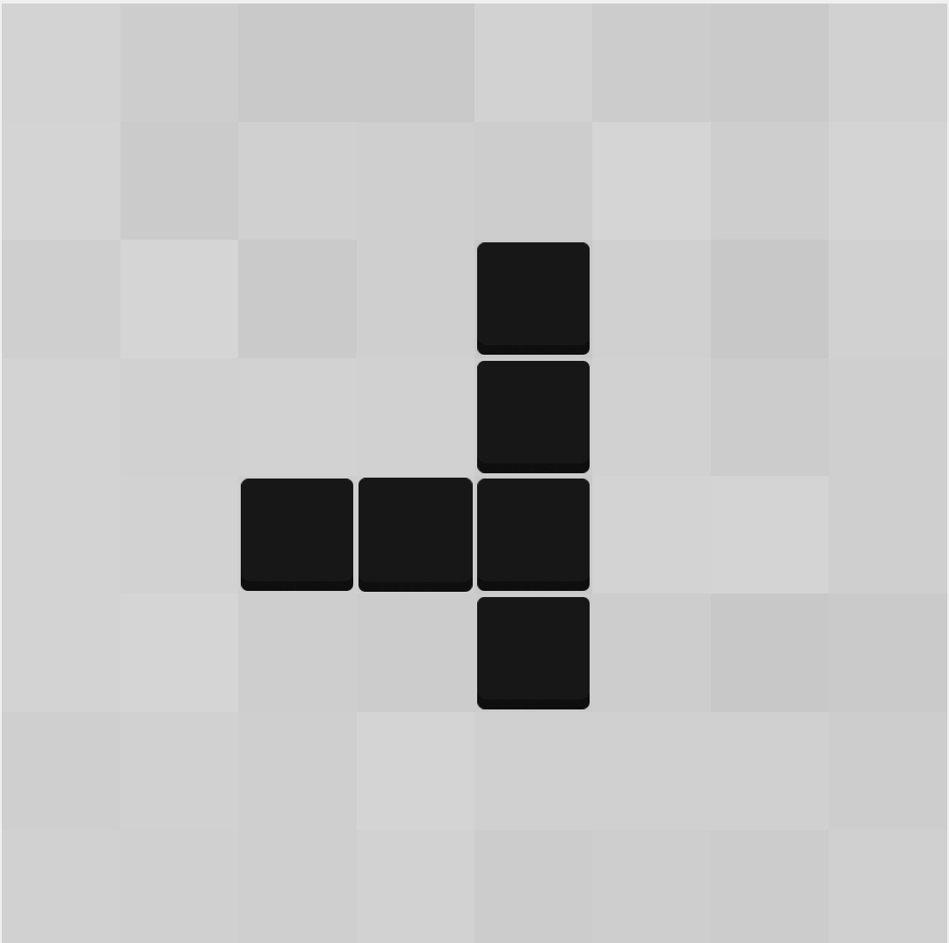
ZHED - Single Player Game
ZHED is a grid based puzzle game where in order to complete each level a numbered cell must be expanded to reach the goal cell.
Each numbered cell can be expanded in one of four directions and overlapped. Each cell expands n cells in the direction chosen, decreasing by one for each empty cell. When a expanding cell overlaps an already filled cell, the number of cells to be filled in the direction of the expansion is not decreased.

Slide 3
Problem Formulation
For each level, the puzzle size and the numbered cells' positions are diferent. Therefore we are using as an example for the formulation a puzzle size of 4.
State Representation: NxN Matrix (List of Lists of integers, N = Puzzle Size), where each cell can have a value, Val, of:
A positive number, representing the expandable length of the cell;
0, representing an empty cell;
-1, representing an expanded cell;
-2, representing the goal cell.
-3, representing the reached goal cell.
Initial State: Matrix with at least one Val = -2 , at least one Val > 0, and no Val = –1 or Val = –3 cells
Final State: Matrix with one Val = -3
1 | 0 | -2 | 0
0 | 0 | 0 | 0
0 | 0 | 0 | 3
0 | 2 | 0 | 0
Initial State example
-1 | -1 | -3 | 0
0 | -1 | 0 | 0
-1 | -1 | -1 | -1
0 | -1 | 0 | 0
Final State example

Slide 4
Operators
Operator | Pre-conditions | Effects | Cost
Move [X,Y] Up | Board(X,Y) > 0 | i = 1; While (i <= Board(X, Y)) If (Board(X, Y – i) != 0) continue; Board(X, Y – i) = -1; i++; | 1
Move [X,Y] Down | Board(X,Y) > 0 | i = 1; While (i <= Board(X, Y)) If (Board(X, Y + i) != 0) continue; Board(X, Y + i) = -1; i++; | 1
Move [X,Y] Left | Board(X,Y) > 0 | i = 1; While (i <= Board(X, Y)) If (Board(X - i, Y) != 0) continue; Board(X - i, Y) = -1; i++; | 1
Move [X,Y] Right | Board(X,Y) > 0 | i = 1; While (i <= Board(X, Y)) If (Board(X + i, Y) != 0) continue; Board(X + i, Y) = -1; i++; | 1

Slide 5
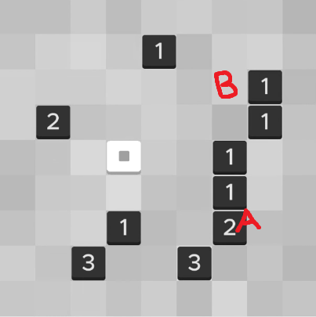
Heuristics
We plan on implementing several search algorithms, such as breadth-first, depth-first, greedy, A*, and comparing the results we achieve.
For the heuristic methods (greedy, A*), we will try different heuristics, such as:
H1 = Minimum Zhed Distance between a Value Cell and a Finish Tile.
H2 = (1 - Number of Reached Finish Tiles) / (Number of tiles aligned with a Finish Tile)
H3 = (1 - Number of Reached Finish Tiles) / Sum(Maximum Tile Reach)
Hx = A combination of previous heuristics
The Zhed Distance between a Value Cell and a Tile, only applicable when they are in the same row or column, consists of:
(The actual distance between them) - (The number of used tiles between the) - (The Cell's Value)
For instance, in this case, the Zhed Distance between A and B is 0, as it can reach the destination with no extra blocks between the path (4 – 2 – 2 = 0)

Slide 6
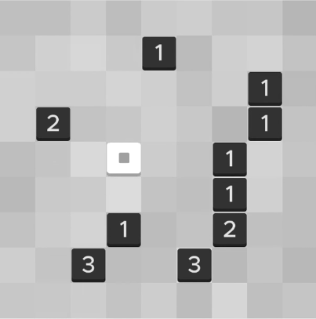
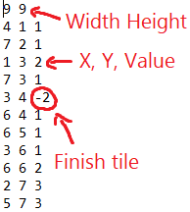
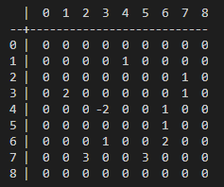
Development
We are using C# as a programming language
We have already developed the game’s logic and got a working console version, where the user can play a predefined level, or one imported from a file,
For Zhed Level 41, its file structure and console representation are shown below:
Zhed App
File representation
Console representation:

Slide 7
Abordagem

Slide 8
Algoritmos implementados

Slide 9
Resultados experimentais

Slide 10
Conclusões

Slide 11
Related Work
https://www.wilgysef.com/articles/zhed-solver/
https://github.com/WiLGYSeF/zhed-solver
https://www.cin.ufpe.br/~if684/EC/aulas-IASimbolica/korf96-search.pdf
http://archive.oreilly.com/oreillyschool/courses/data-structures-algorithms/singlePlayer.html
http://www.pvv.ntnu.no/~spaans/spec-cs.pdf

